Slide 1
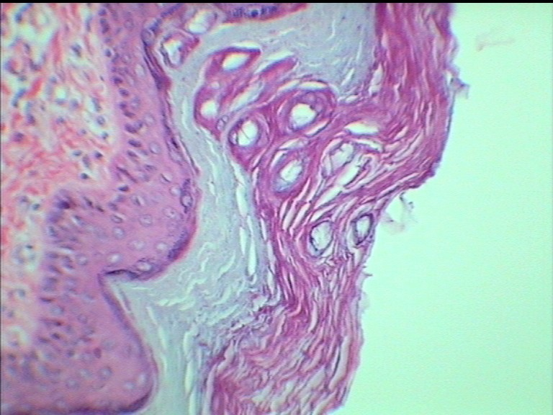
Sweat gland duct
Notes:
Thick skin

Slide 2
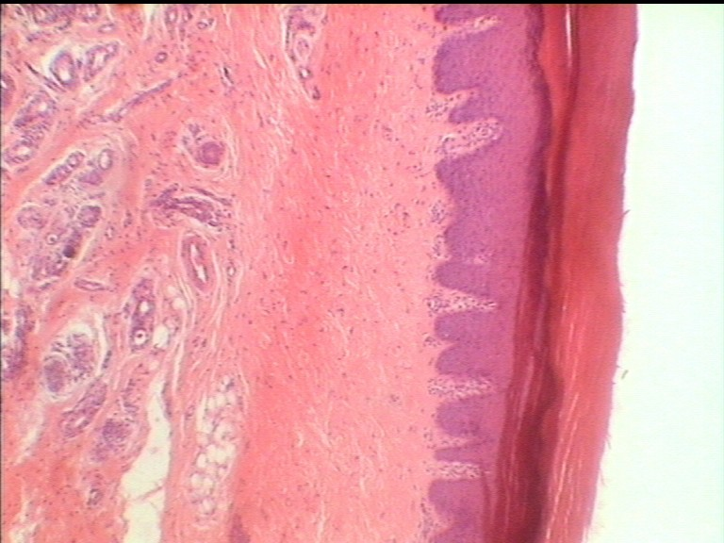
Notes:
Thick skin

Slide 3
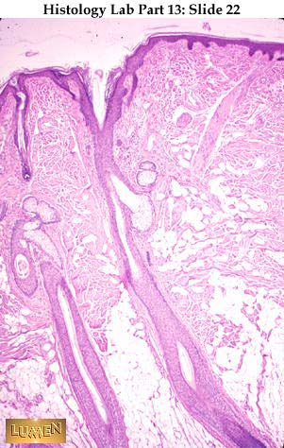
THIN SKIN
SEBACEOUS GLANDS
HAIR FOLLICLE
Notes:
Thin skin

